Slide 1


Vanguard’s Journey to Maximizing Customer Experience
From A/B Testing to Data-Driven Decisions

Slide 2

Vanguard’s Journey to Maximizing Customer Experience
The Challenge: Maximize digital customer experience.
Importance of a modern UI: In today's digital age, user experience is crucial
Customer Life Time Value: Customer Satisfaction |Retention
Market Expansion: Customer Acquisition
Business Metrics: Sales | Revenue | Cost saving | Operational efficiency

Slide 3
Vanguard’s Journey to Maximizing Customer Experience
The Challenge: Maximize digital customer experience.
Importance of a modern UI: In today's digital age, user experience is crucial
Customer Life Time Value: Customer Satisfaction |Retention
Market Expansion: Customer Acquisition
Business Metrics: Sales | Revenue | Cost saving | Operational efficiency
Can a more intuitive and modern UI streamline the online process and reduce friction points for users?

Slide 4
Vanguard’s Journey to Maximizing Customer Experience
The Challenge: Maximize digital customer experience.
Importance of a modern UI: In today's digital age, user experience is crucial
Customer Life Time Value: Customer Satisfaction |Retention
Market Expansion: Customer Acquisition
Business Metrics: Sales | Revenue | Cost saving | Operational efficiency
Can a more intuitive and modern UI streamline the online process and reduce friction points for users?
Experiment Setup: To test this hypothesis, an A/B experiment was conducted from March 15 to June 20 2017

Slide 5
Vanguard’s Journey to Maximizing Customer Experience
The Challenge: Maximize digital customer experience.
Importance of a modern UI: In today's digital age, user experience is crucial
Customer Life Time Value: Customer Satisfaction |Retention
Market Expansion: Customer Acquisition
Business Metrics: Sales | Revenue | Cost saving | Operational efficiency
Can a more intuitive and modern UI streamline the online process and reduce friction points for users?
Experiment Setup: To test this hypothesis, an A/B experiment was conducted from March 15 to June 20, 2017
Test Group: Clients experiencing the new, enhanced UI with in-context prompts.
Allows to observe the effects of the new UI.
Control Group: Clients interacting with Vanguard's traditional online process.
Sets the experiment baseline.
Online Process Sequence: Both groups followed the same sequence of steps.
Initial Page → Step 1 → Step 2 → Step 3 → Confirmation Page

Slide 6
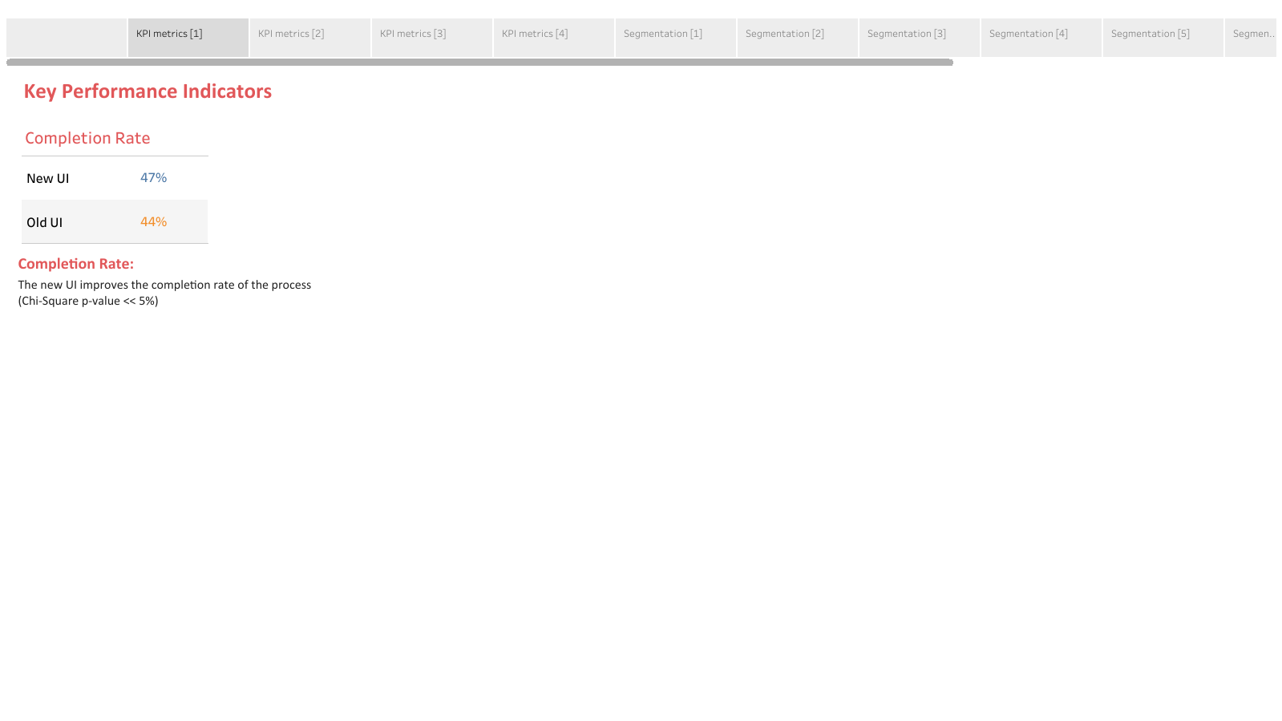
Vanguard’s Journey to Maximizing Customer Experience
Key Performance Indicators
Completion Rate
Completion Rate:
The new UI improves the completion rate of the process
(Chi-Square p-value <<< 5%)
Completion Rate:
The new UI improves the completion rate of the process
(p-value <<< 5%)

Slide 7
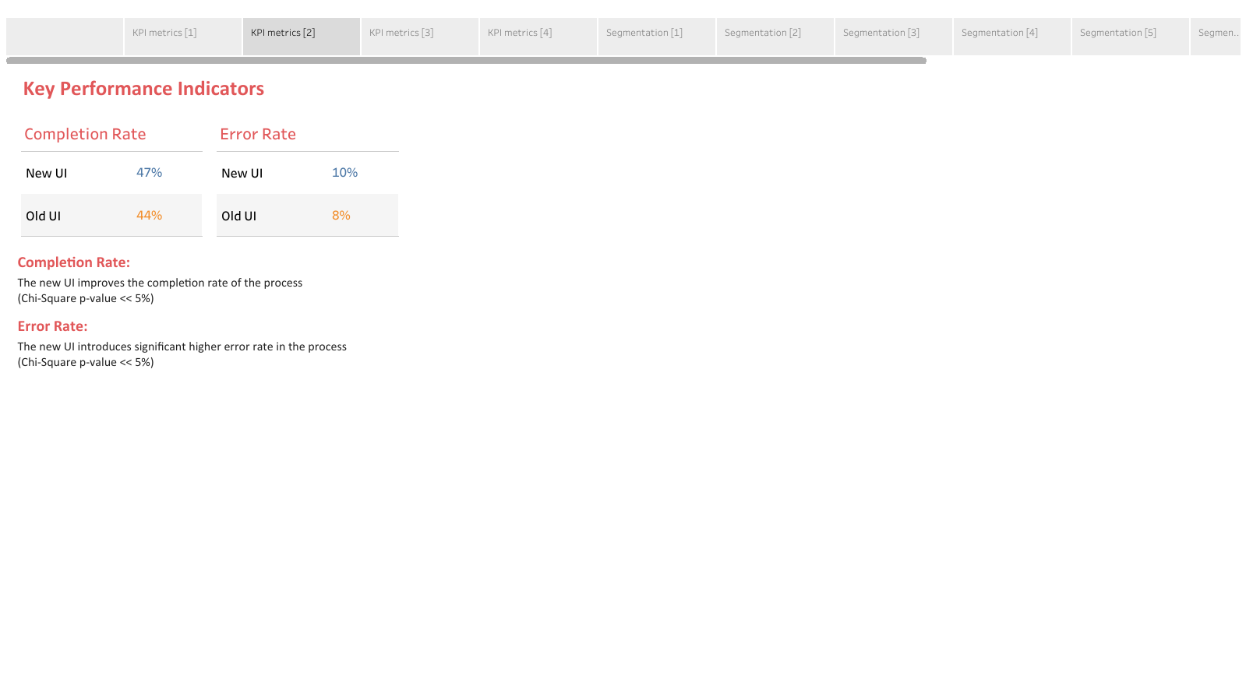
Vanguard’s Journey to Maximizing Customer Experience
Key Performance Indicators
Completion Rate
Error Rate
Completion Rate:
The new UI improves the completion rate of the process
(p-value <<< 5%)
Error Rate:
The new UI introduces significant higher error rate (p-value <<< 5%)

Slide 8
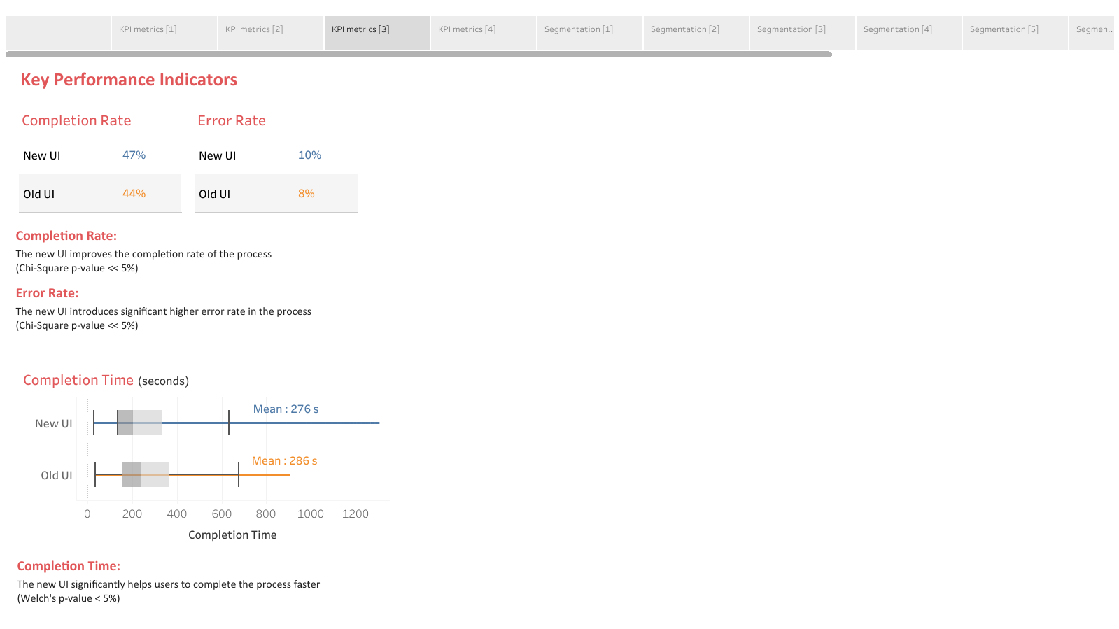
Vanguard’s Journey to Maximizing Customer Experience
Key Performance Indicators
Completion Rate
Error Rate
Completion Rate:
The new UI improves the completion rate of the process
(p-value <<< 5%)
Error Rate:
The new UI introduces significant higher error rate (p-value <<< 5%)
Completion Time _{sec}
Completion Time:
The new UI significantly helps users to complete the process faster
(p-value << 5%)

Slide 9
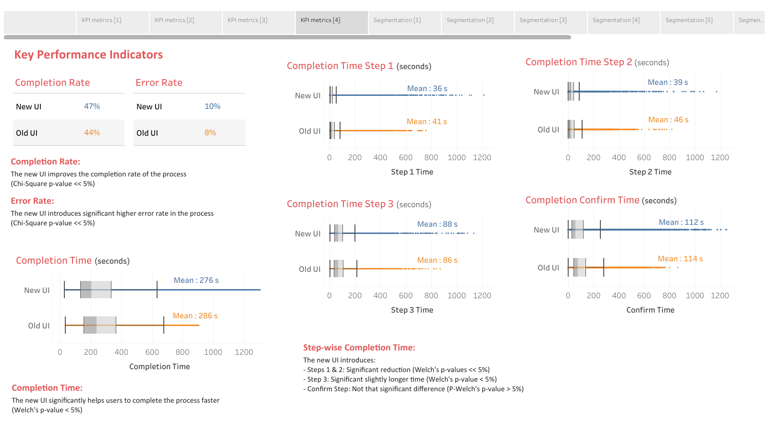
Vanguard’s Journey to Maximizing Customer Experience
Key Performance Indicators
Completion Time Step 2 _{sec}
Completion Time Step 1 _{sec}
Completion Rate
Error Rate
Completion Rate:
The new UI improves the completion rate of the process
(p-value <<< 5%)
Error Rate:
The new UI introduces significant higher error rate (p-value <<< 5%)
Completion Time Step 3 _{sec}
Completion Time Confirm _{sec}
Completion Time _{sec}
Step-wise Completion Time:
The new UI introduces:
- Steps 1 & 2: Significant reduction (p-values <<< 5%)
- Step 3: Significant slightly longer time (p-value < 5%)
- Confirm Step: No significant difference (p-value >> 5%)
Completion Time:
The new UI significantly helps users to complete the process faster
(p-value << 5%)

Slide 10
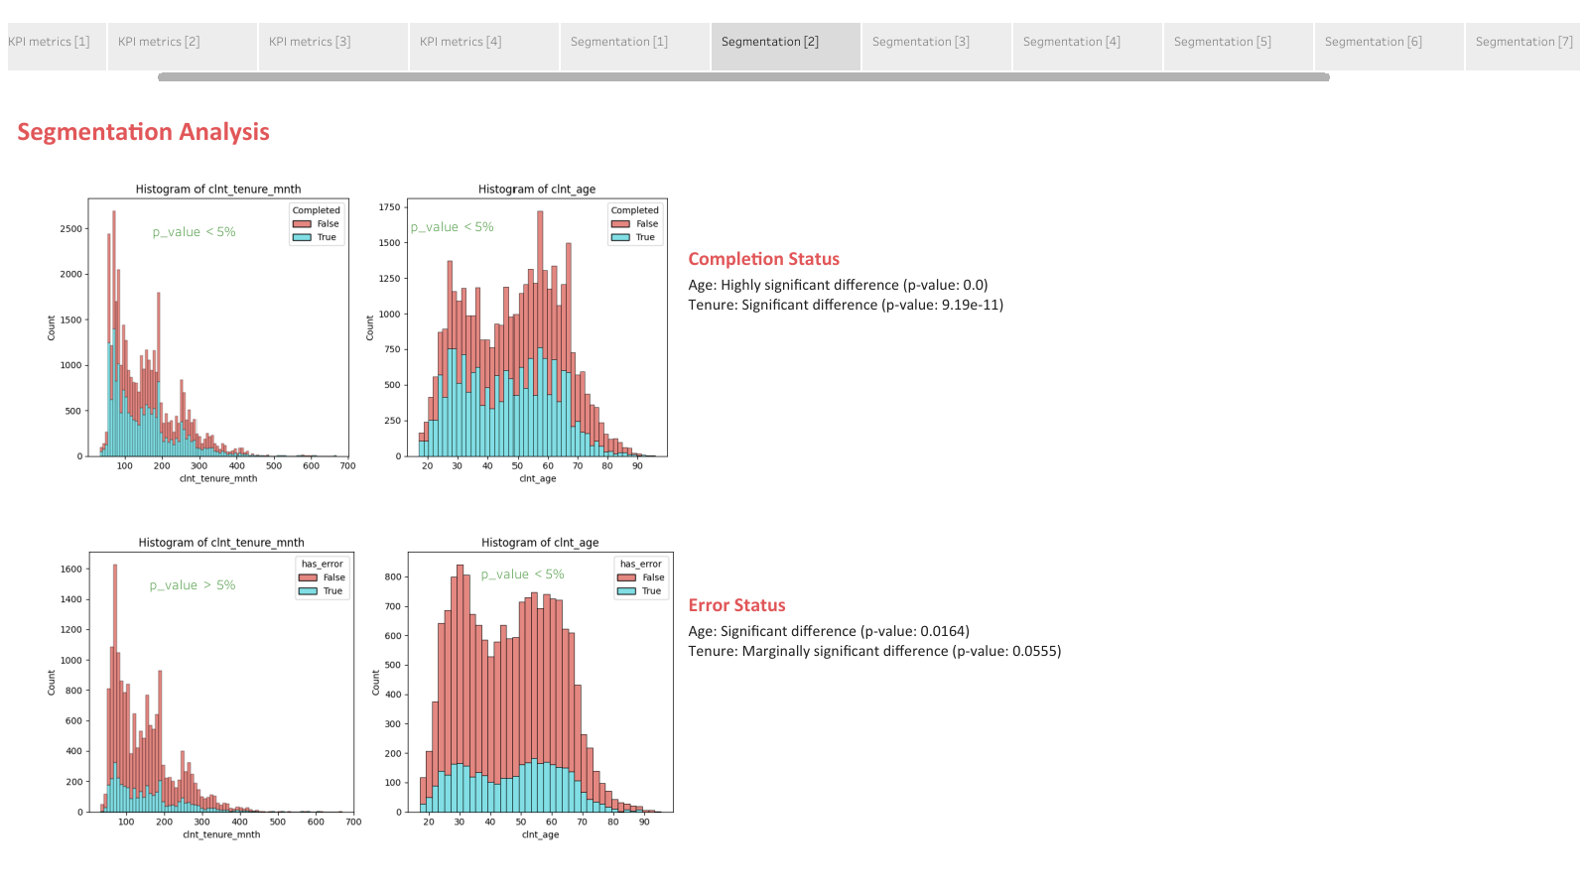
Vanguard’s Journey to Maximizing Customer Experience
Segmentation Analysis
Completion Status
Tenure: Highly Significant difference (p-value <<< 5%)
Age: Highly significant difference (p-value ~0)

Slide 11
Vanguard’s Journey to Maximizing Customer Experience
Segmentation Analysis
Completion Status
Tenure: Highly Significant difference (p-value <<< 5%)
Age: Highly significant difference (p-value ~0)
Error Status
Tenure: Marginally significant difference (p-value ~5%)
Age: Significant difference (p-value < 5%)

Slide 12
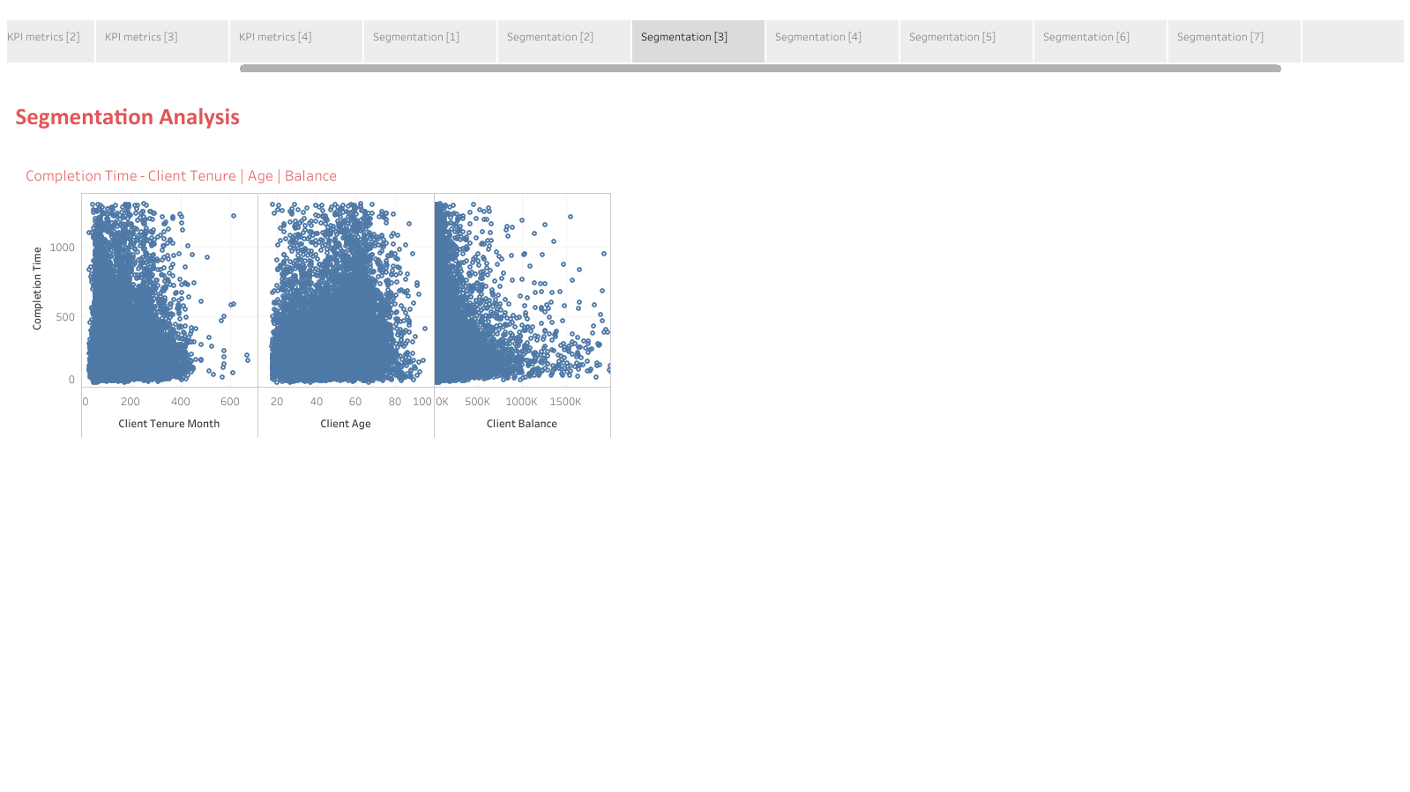
Vanguard’s Journey to Maximizing Customer Experience
Segmentation Analysis
Completion Time - Client Tenure | Age | Balance

Slide 13
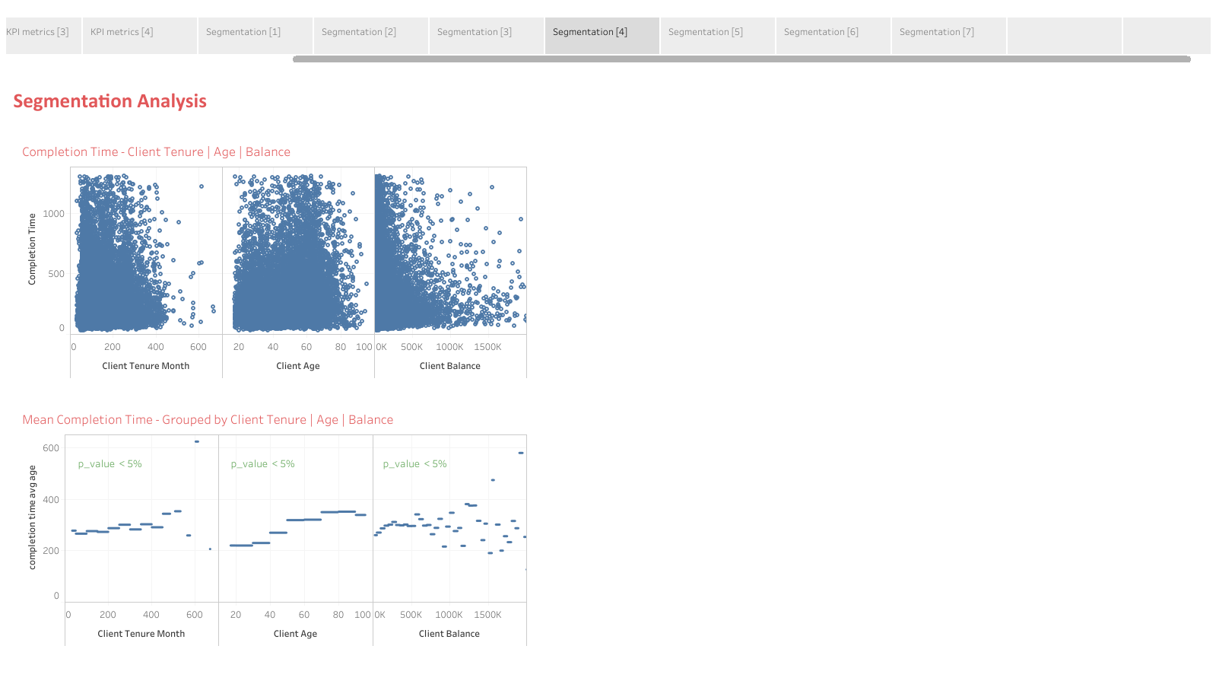
Vanguard’s Journey to Maximizing Customer Experience
Segmentation Analysis
Completion Time - Client Tenure | Age | Balance
Mean Completion Time - Client Tenure | Age | Balance

Slide 14
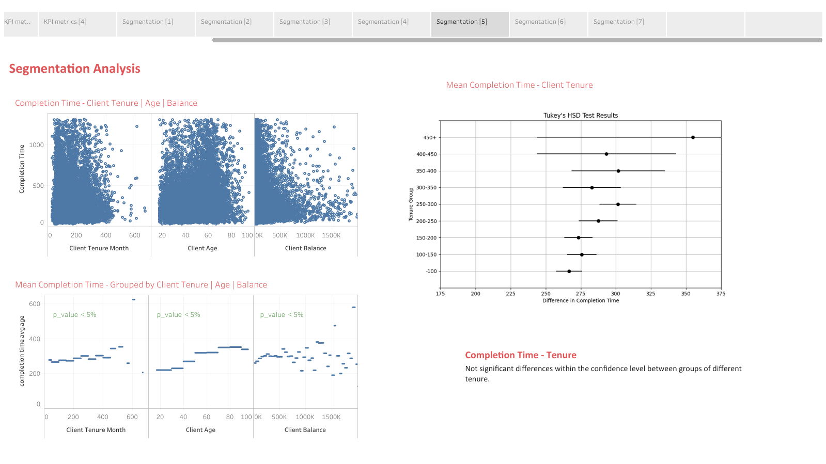
Vanguard’s Journey to Maximizing Customer Experience
Segmentation Analysis
Completion Time - Client Tenure | Age | Balance
Mean Completion Time - Client Tenure
Mean Completion Time - Client Tenure | Age | Balance
Completion Time – Client Tenure
No significant differences within the confidence level between groups of different tenure.

Slide 15

Vanguard’s Journey to Maximizing Customer Experience
Segmentation Analysis
Completion Time - Client Tenure | Age | Balance
Mean Completion Time - Client Age
Mean Completion Time - Client Tenure | Age | Balance
Completion Time – Client Age
Highly significant differences between groups of different age.
Clients < 40 yrs old | faster completion times

Slide 16

Vanguard’s Journey to Maximizing Customer Experience
Segmentation Analysis
Completion Time - Client Tenure | Age | Balance
Mean Completion Time - Client Balance
Mean Completion Time - Client Tenure | Age | Balance
Completion Time – Client Balance
No significant differences between groups of different balance.

Slide 17
Vanguard’s Journey to Maximizing Customer Experience
Data-driven recommendations
KPI: Completion Rate & Time
Significant higher completion rate and faster completion time
The new UI improves overall user engagement and ensures fast process completion

Slide 18
Vanguard’s Journey to Maximizing Customer Experience
Data-driven recommendations
KPI: Completion Rate & Time
Significant higher completion rate and faster completion time
The new UI improves overall user engagement and ensures fast process completion
KPI: Step-wise Completion Time
Significant reduction in time to complete Steps 1 & 2 unlike the last two steps (Step 3 and Confirmation)
KPI: Error Rates
Significant higher error rate in the online process
While the new UI reduces overall completion time,
- Steps monitoring to ensure consistent performance improvements
- Refinement of Steps 3 and Confirmation to further streamline the process
- Address Error-Prone Areas: Investigate the higher error rates in the new UI

Slide 19
Vanguard’s Journey to Maximizing Customer Experience
Data-driven recommendations
KPI: Completion Rate & Time
Significant higher completion rate and faster completion time
The new UI improves overall user engagement and ensures fast process completion
KPI: Step-wise Completion Time
Significant reduction in time to complete Steps 1 & 2 unlike the last two steps (Step 3 and Confirmation)
KPI: Error Rates
Significant higher error rate in the online process
While the new UI reduces overall completion time,
- Steps monitoring to ensure consistent performance improvements
- Refinement of Steps 3 and Confirmation to further streamline the process
- Address Error-Prone Areas: Investigate the higher error rates in the new UI
Segmentation Analysis
The new UI impacts different user segments (age, tenure, balance) differently
UI tailored to user segments to enhance usability for all users

Slide 20
Vanguard’s Journey to Maximizing Customer Experience
Data-driven recommendations
KPI: Completion Rate & Time
Significant higher completion rate and faster completion time
The new UI improves overall user engagement and ensures fast process completion
KPI: Step-wise Completion Time
Significant reduction in time to complete Steps 1 & 2 unlike the last two steps (Step 3 and Confirmation)
KPI: Error Rates
Significant higher error rate in the online process
While the new UI reduces overall completion time,
- Steps monitoring to ensure consistent performance improvements
- Refinement of Steps 3 and Confirmation to further streamline the process
- Address Error-Prone Areas: Investigate the higher error rates in the new UI
Segmentation Analysis
The new UI impacts different user segments (age, tenure, balance) differently
UI tailored to user segments to enhance usability for all users
User Feedback Integration | Iterative Improvements Comprehensive Training | Monitoring and Analysis

Slide 22
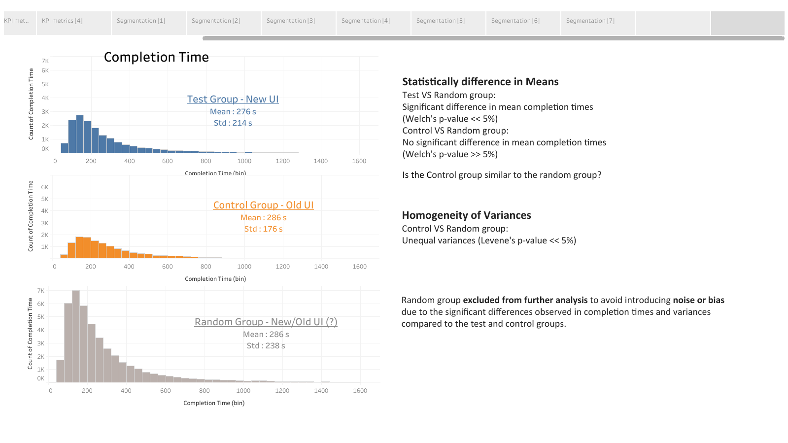
Vanguard’s Journey to Maximizing Customer Experience

